Slide 1


PYTHON
Lecture 46

Slide 2

Today’s Agenda
Advance Concepts Of Object Oriented Programming-IV
Multiple Inheritance
The MRO Algorithm
Hybrid Inheritance
The Diamond Problem

Slide 3
Multiple Inheritance
Like C++, in Python also a class can be derived from more than one base class.
This is called multiple inheritance.
In multiple inheritance, the features of all the base classes are inherited into the derived class.

Slide 4
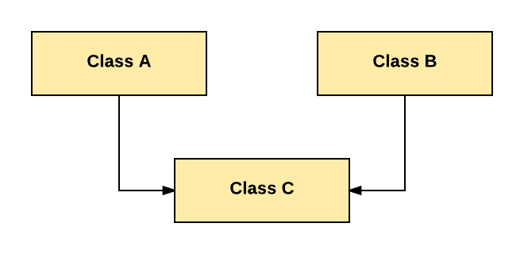
Multiple Inheritance

Slide 5
Syntax
class A:
# properties of class A
class B:
#properties of class B
class C(A,B):
# class C inheriting property of class A
# class C inheriting property of class B
# more properties of class C

Slide 6
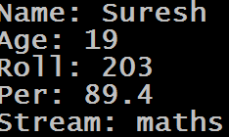
Example
class ScienceStudent(Person,Student):
def __init__(self,name,age,roll,per,stream):
Person.__init__(self,name,age)
Student.__init__(self,roll,per)
self.stream=stream
def getstream(self):
return self.stream
ms=ScienceStudent("Suresh",19,203,89.4,"maths")
print("Name:",ms.getname())
print("Age:",ms.getage())
print("Roll:",ms.getroll())
print("Per:",ms.getper())
print("Stream:",ms.getstream())
Output:
class Person:
def __init__(self,name,age):
self.name=name
self.age=age
def getname(self):
return self.name
def getage(self):
return self.age
class Student:
def __init__(self,roll,per):
self.roll=roll
self.per=per
def getroll(self):
return self.roll
def getper(self):
return self.per

Slide 7
Guess The Output ?
class A:
def m(self):
print("m of A called")
class B:
def m(self):
print("m of B called")
class C(A,B):
pass
obj=C()
obj.m()
Output:
Why did m( ) of A got called ?
This is because of a special rule in Python called MRO

Slide 8
What Is MRO In Python ?
In languages that use multiple inheritance, the order in which base classes are searched when looking for a method is often called the Method Resolution Order, or MRO.
MRO RULE :
In the multiple inheritance scenario, any specified attribute is searched first in the current class. If not found, the search continues into parent classes, left-right fashion and then in depth-first without searching same class twice.

Slide 9
Can We See This MRO ?
Yes, Python allows us to see this MRO by calling a method called mro( ) which is present in every class by default.

Slide 10
Example
class A:
def m(self):
print("m of A called")
class B:
def m(self):
print("m of B called")
class C(A,B):
pass
print(C.mro())
Output

Slide 11
Another Way To See MRO ?
There is a tuple also called __mro__ made available in every class by Python using which we can get the same output as before

Slide 12
Example
class A:
def m(self):
print("m of A called")
class B:
def m(self):
print("m of B called")
class C(A,B):
pass
print(C.__mro__)
Output

Slide 13
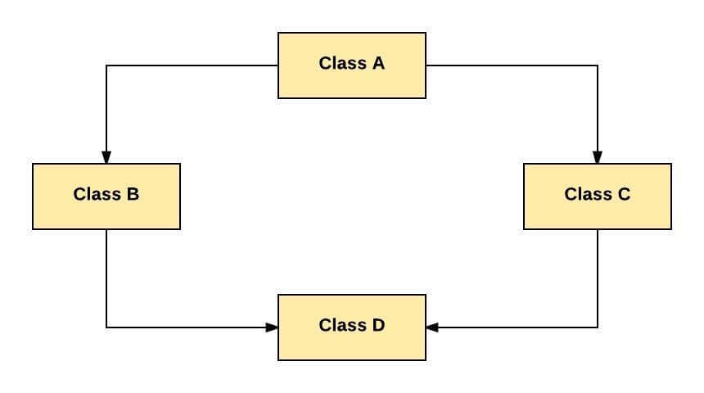
The Hybrid Inheritance
This form combines more than one form of inheritance. Basically, it is a blend of more than one type of inheritance.

Slide 14

Example
class A:
def m1(self):
print("m1 of A called")
class B(A):
def m2(self):
print("m2 of B called")
class C(A):
def m3(self):
print("m3 of C called")
class D(B,C):
pass
Output:
obj=D()
obj.m1()
obj.m2()
obj.m3()

Slide 15
The Diamond Problem
The “diamond problem” is the generally used term for an ambiguity that arises in hybrid inheritance .
Suppose two classes B and C inherit from a superclass A, and another class D inherits from both B and C.
If there is a method "m" in A that B and C have overridden, then the question is which version of the method does D inherit?

Slide 16
Guess The Output
class A:
def m(self):
print("m of A called")
class B(A):
def m(self):
print("m of B called")
class C(A):
def m(self):
print("m of C called")
class D(B,C):
pass
Output:
obj=D()
obj.m()
Why m() of B was called ?
As discussed previously , Python uses MRO to search for an attribute which goes from left to right and then in depth first. Now since B is the first inherited class of D so Python called m( ) of B

Slide 17
Guess The Output
class A:
def m(self):
print("m of A called")
class B(A):
def m(self):
print("m of B called")
class C(A):
def m(self):
print("m of C called")
class D(C,B):
pass
Output:
obj=D()
obj.m()

Slide 18
Guess The Output
class A:
def m(self):
print("m of A called")
class B(A):
pass
class C(A):
def m(self):
print("m of C called")
class D(B,C):
pass
Output:
obj=D()
obj.m()
Why m() of C was called ?
MRO goes from left to right first and then depth first. In our case Python will look for method m() in B but it won’t find it there . Then it will search m() in C before going to A. Since it finds m() in C, it executes it dropping the further search

Slide 19
Guess The Output
class A:
def m(self):
print("m of A called")
class B(A):
def m(self):
print("m of B called")
class C(A):
def m(self):
print("m of C called")
class D(B,C):
def m(self):
print("m of D called")
Output:
obj=D()
obj.m()

Slide 20
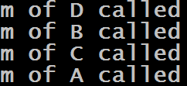
Guess The Output
class A:
def m(self):
print("m of A called")
class B(A):
def m(self):
print("m of B called")
class C(A):
def m(self):
print("m of C called")
class D(B,C):
def m(self):
print("m of D called")
B.m(self)
C.m(self)
A.m(self)
Output:
obj=D()
obj.m()

Slide 21
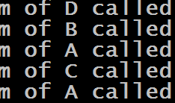
Guess The Output
class A:
def m(self):
print("m of A called")
class B(A):
def m(self):
print("m of B called")
A.m(self)
class C(A):
def m(self):
print("m of C called")
A.m(self)
class D(B,C):
def m(self):
print("m of D called")
B.m(self)
C.m(self)
Output:
obj=D()
obj.m()
Why m() of A was called twice?
This is because we have called A.m(self) in both B and C classes due to which the method m() of A gets called 2 times

Slide 22
Using super( ) To Solve The Previous Problem
In the previous code the method m( ) of A was getting called twice.
To resolve this problem we can use super( ) function to call m() from B and C .
As previously mentioned Python follows MRO and never calls same method twice so it will remove extra call to m( ) of A and will execute m() only once

Slide 23
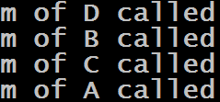
Guess The Output
class A:
def m(self):
print("m of A called")
class B(A):
def m(self):
print("m of B called")
super().m()
class C(A):
def m(self):
print("m of C called")
super().m()
class D(B,C):
def m(self):
print("m of D called")
super().m()
Output:
obj=D()
obj.m()

